Slide 1

XXVIII Interamerican Congress of Chemical Engineering Cuzco Perú
Analysis of the influence of fouling factor on the heat recovery in a heat exchanger network of a crude distillation unit
Diego Uriarte Cáceres / Carlos Márquez Quispe

Slide 2
CONTENT
1. Introduction
2. Data processing
3. Calculation methodology
4. Case study: CDU, La Pampilla Refinery
5. Conclusion

Slide 3
1. INTRODUCTION

Slide 4
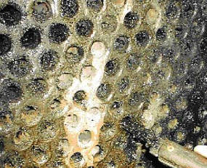
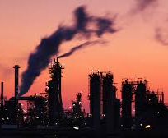
FOULING IN PRE-HEAT TRAINS
Fouling:
Deposition of any undesired material on heat transfer surface.
Theory:
Reduces termal and hydraulic performance of a heat exchangers.
Increases the overall termal resistance and lowers the overall heat transfer coefficient of heat exchangers.
Operative consequences:
Increase operating costs since more energy must be provided by the fired heater.
Increase the emission of greenhouse gases and other pollutants.

Slide 5
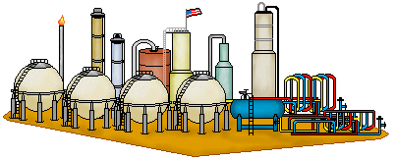




ACTUAL ANALYSIS OF FOULING IN A HEN
1. Collection of raw data from Plant Information System.
Measured temperatures, volumetric flowrates and crude oil API° of streams of the HEN*.
Data
2. Steady-state detection.
Calculation of the average values of the most stable periods in a day using an algorithm in Excel VBA.
3. Data reconciliation.
Calculation of reconciled temperatures and mass flow of each stream across the HEN using an algorithm in Excel VBA.
4. Fouling Factor and NFIT calculation
Manually input data to a Hysys file and calculation of each fouling factor across the HEN and NFIT** using Aspen EDR from Aspen Tech.
90- 120 minutes to analyze performance of HEN each day!
* HEN: Heat Exchanger Network.
** NFIT: Normalized Furnace Inlet Temeprature.

Slide 6

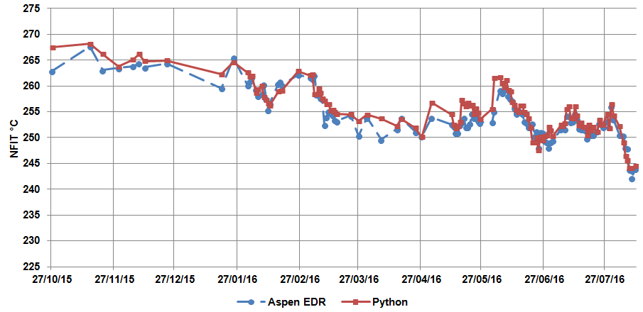
OBJECTIVE OF THIS PAPER
Develop and implement a methodology to monitor the thermal efficiency of each heat exchanger and the HEN with the minimum user interaction.
Only one algorithm for the whole procedure:
Steady-state detection.
Data reconciliation.
Fouling and NFIT calculation.
Data
This program using Python can help to:
Select which heat exchanger of the HEN should be removed for cleaning.
Program a heat exchanger cleaning schedule

Slide 7
2. DATA PROCESSING

Slide 8


DATA PROCESSING
1. Collect HEN operational data and indetify stable periods.
Information collected every 15 minutes.
Period of steadiness: 3 hours.
Stability of a period: CV* < 1%.
Data
2. Close heat and mass balance for each heat exchanger of the HEN.
Application of SLQSP** for the whole HEN.
Data conciliation to account for the errors expected on instruments.
reconciled temperature
(after closing heat and mass balance)
$$\overline{T_{i}}=T_{i}+ε$$
error in instrument
measured temperature
CV: Coefficient of variation.
** SLSQP: Sequential Least Squares Programming.

Slide 9



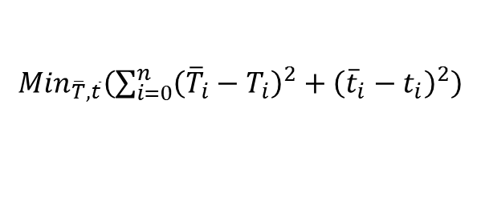

DATA PROCESSING
reconciled temperature
(after closing heat and mass balance)
$$\overline{T_{i}}=T_{i}+ε$$
error in instrument
measured temperature
Heat balances around heat exchanger:
$Duty_{shell}{HX}_{i}={Duty}_{tubes} {HX}_{i}$
$$m_{shell}∗{cp}_{shell}∗\left(t_{i}−t_{i+1}\right)=m_{tubes}∗{cp}_{tubes}∗(T_{i−1}−T_{i})$$
Since the measured values do not satisfy the above equations, the differences between measured and estimated temperatures should be as small as posible:
${Min}_{\overline{T},\overline{t}}\left(\sum_{i=0}^{n}{{\left({\overline{T}}_{i}−T_{i}\right)}^{2}+{\left({\overline{t}}_{i}−t_{i}\right)}^{2}}\right)$
$$\overline{T}=\left[\overline{T_{i}},\overline{T_{2}},…,\overline{T_{n}}\right]$$
$\overline{t}=\left[\overline{t_{i}},\overline{t_{2}},…,\overline{t_{n}}\right]$

Slide 10
3. CALCULATION METHODOLOGY

Slide 11



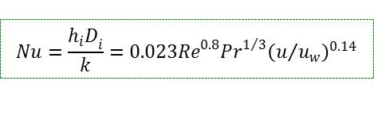

CALCULATION METHODOLOGY – FOULING FACTOR
INPUT DATA
HEN Data Sheet
Operational Data (reconciled temperatures and volumetric flows
CALCULATION
Physical properties
(API Technical Databook)
Tube side heat transfer coeff. hi
Shell side heat transfer coeff. ho
$$Nu=\frac{{h_{i}D}_{i}}{k}=0.023{Re}^{0.8}{Pr}^{1/3}{\left(u/{u_{w}}\right)}^{0.14}$$
$$h_{o}=h_{ideal }\left(J_{C}J_{L}J_{B}J_{R}J_{S}\right)$$
Clean overall heat transfer coeff. Uc
Dirty overall heat transfer coeff. Ud
$$U_{c}=\left[\frac{D_{o}}{h_{i}D_{i}}+\frac{\left.D_{o}ln{(}{D_{o}}/{D_{i}}\right)}{2k}+\frac{1}{h_{o}}\right]$$
$$U_{d}=\frac{Q}{A∗∆T}$$
Fouling factor Rf
$$R_{f}=\frac{1}{U_{d}}−\frac{1}{U_{c}}$$

Slide 12
CALCULATION METHODOLOGY - NFIT
INPUT DATA
HEN Data Sheet
Operational Data (reconciled temperatures and volumetric flows
CALCULATION
Physical properties
(API Technical Databook)
Tube side heat transfer coeff. hi
Shell side heat transfer coeff. ho
$$Nu=\frac{{h_{i}D}_{i}}{k}=0.023{Re}^{0.8}{Pr}^{1/3}{\left(u/{u_{w}}\right)}^{0.14}$$
$$h_{o}=h_{ideal }\left(J_{C}J_{L}J_{B}J_{R}J_{S}\right)$$
Clean overall heat transfer coeff. Uc
Dirty overall heat transfer coeff. Ud
$$U_{c}=\left[\frac{D_{o}}{h_{i}D_{i}}+\frac{\left.D_{o}ln{(}{D_{o}}/{D_{i}}\right)}{2k}+\frac{1}{h_{o}}\right]$$
$$U_{d}=\frac{Q}{A∗∆T}$$
Fouling factor Rf
$$R_{f}=\frac{1}{U_{d}}−\frac{1}{U_{c}}$$

Slide 13
4. CASE STUDY: CDU, LA PAMPILLA REFINERY

Slide 14
CASE STUDY
HEN of the main CDU at La Pampilla Refinery, Callao, Perú.
Data retrieval from Plant Information System every 15 minutes since the unit startup after general maintenance (October 2015 to August 2016).
(inlet and outlet temperatures for each heat exchanger, standar volumetric flows of most of the products that enter the HEN and specific gravities)
From 36 values needed to close the mass and energy balance in the HEN, three were not know and had to be calculated in the reconciliation step.

Slide 15
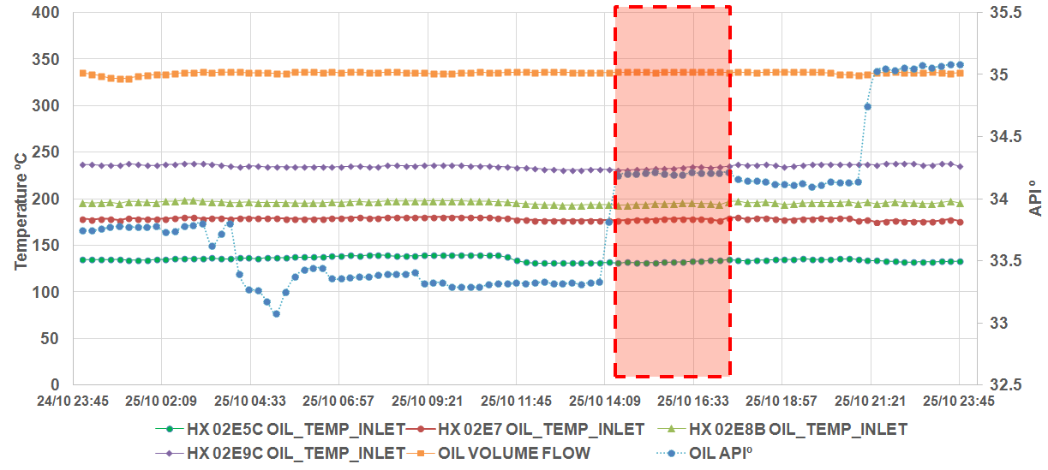
CASE STUDY
Steady-state detection.
Steady state selected by python program.

Slide 16
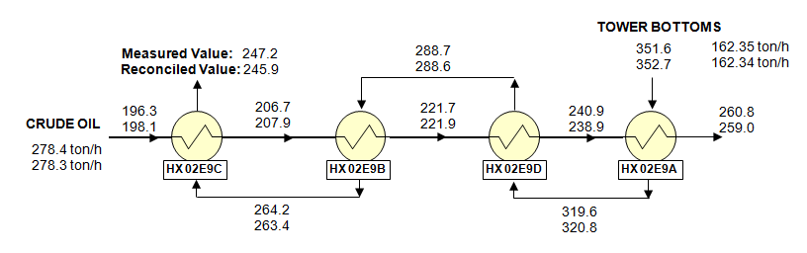
CASE STUDY
Data reconciliation.
Measured and reconciled temperatures for a portion of the HEN.

Slide 17
CASE STUDY
Fouling and NFIT reconciliation.
Comparison of NFIT values calculated using Aspen EDR and Python

Slide 18
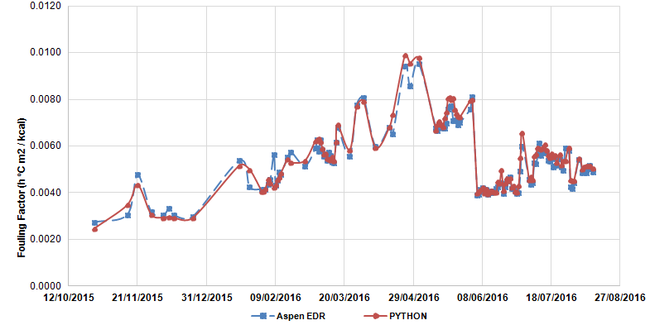
CASE STUDY
Fouling and NFIT reconciliation.
Fouling factor decrease since the flow to heat exchanger increased and helped to clean the unit by removing deposits.
Comparison of fouling values for HX02E5C

Slide 19
CASE STUDY
Economic impact of cleaning a group of heat exchangers.
A subroutine in Python was written to determine which clean heat exchanger provided the greatest increase in the NFIT.
In addition, the program calculated the economic savings in fuel oil not burned in the fired heater over a month period after the cleaning.
The expected savings when cleaning the HX E9C/B were 6.8 KUS$ after the first moth and for the next three motnhs were 194 KUS$.

Slide 20
5. conclusions

Slide 21
CONCLUSIONS
The present work showed that the monitoring of the overall fouling of a Heat Exchange Network can be done with a procedure written in the Python Programming Language since it returns similar results to the values calculated by commercial software (Aspen Hysys + EDR).
This approach has also advantages over commercial fouling monitor software since it can accommodate the particular configuration of a given plant, automatically retrieve data from the Plant Information System and can be implemented using Open Source software without cost to the end user.
In addition, the proposed methodology helps to select the heat exchanger with the greatest effect in the HEN and to timely propose a cleaning schedule that can provide a significant return of investment and help to reduce CO₂ emissions.

Slide 22
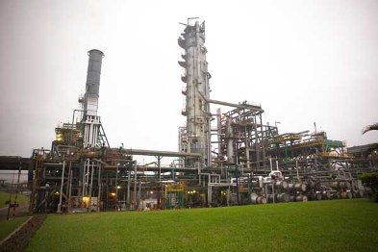
THANKS!

